Slide 1
Weak Supervision for Fake News Detection via Reinforcement Learning
Dimitris Glikiotis

Slide 2
Abstract
Social media is one of the main ways of information. More than 68% of American adults get news on social media at least occasionally.
Fake news: Intentionally and verifiably false news stories
The spread of fake news may bring many negative impacts, including social panic and financial loss.
There is a need for identifying and stopping the spreading of the fake news in social media platforms.

Slide 3
Most common ways to identify fake news
Traditional learning models.
Typically extract features from news articles and train classifiers based on the extracted features.
Deep learning models.
+ improvement in the performance of fake news detection due to their powerful abilities of learning informative representations.
- Requires a large amount of hand-labeled data (Expensive)
- Data can be quickly outdated and irrelevant
- Lack of fresh high-quality samples for training
Possible solution for input data: Leverage the feedback provided by users who read the news.

Slide 4
Proposal: WEakly-supervised FakE News Detection framework (WeFEND)
Problem: Label shortage issue -> Proposal: Leverage user reports as weak supervision
WeFEND framework can automatically annotate articles, which help enlarge the size of the training set and this means success of deep learning models in fake news detection
Reinforcement learning techniques: WeFEND has the ability of selecting high-quality samples.
The article empirically shows that WeFEND can identify fake news and outperform other fake news detection models

Slide 5
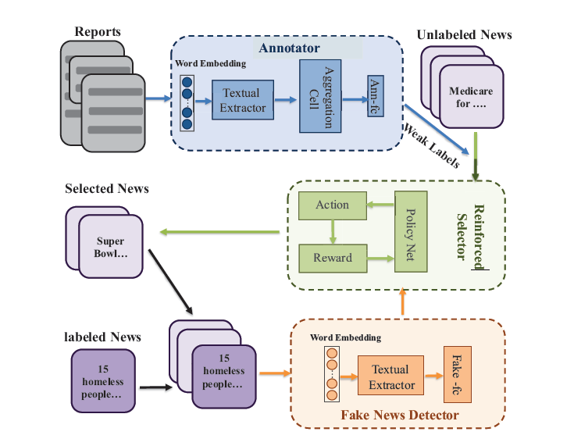
Methodology
Annotator: pretrained model on reports with their labels that can assign weak labels on unlabeled samples.
Reinforced Selector: Designed to automatically choose high-quality samples, by exploiting reinforcement learning techniques.
Fake News Detector: We use the originally labeled samples and the selected samples from the selector to train the Fake News Detector
Textual Feature Extractor: Both the annotator and the fake news detector modules use a Textual Feature Extractor based on a convolutions neural network

Slide 6
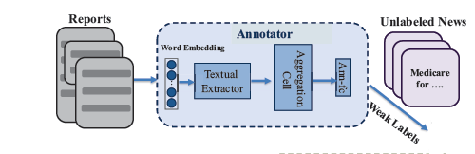
Annotator
Automatic Annotation based on Reports
The report messages from multiple users for one piece of news are permutation invariant. Therefore, there can be designed an aggregation cell consisting of a commutative aggregation function and a fully connected layer.
Given the unlabeled news set X with corresponding reports as input
we use the trained annotator to predict their
labels, which are denoted as Y.
This can produce noisy results and thus the challenge is to select high quality samples from Y set.

Slide 7
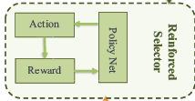
Data Selection via Reinforcement Learning 1/2
The objective of the data selector is to automatically select
high-quality samples from those with weak labels obtained
from the annotator.
According to this criteria, we
design a performance-driven data selection method (called
reinforced data selector) using reinforcement learning mechanism.
The selector divides the whole dataset
into K small bags of data samples, i.e., X = { X (k)}Kk=1.
By using multiple small bags of samples we provide more
feedback to the selector and this makes the training procedure
of reinforcement learning more efficient
For every sample, the action of reinforced data selector is to retain or remove. The decision
of the current sample x(k)i is based on its state vector and all the previous decisions of samples {x(k)1 , x(k)2 , ..., x(k)i−1}.

Slide 8
Data Selection via Reinforcement Learning 2/2
State Vector [(s(k)i]
output probability from the annotator
the output probability from fake news detector
the maximum of cosine similarity between the current sample and the chosen samples
the weak label of the current sample
Action
1 represents the action to retain the sample
0 represents the action to remove the sample
This result is produced by a Policy network which includes two fully connected layers with corresponding activation functions
Reward
The reward of Data Selection via Reinforcement Learning is the maximized accuracy on detecting the fake news on any sample.
Notes:
x

Slide 9
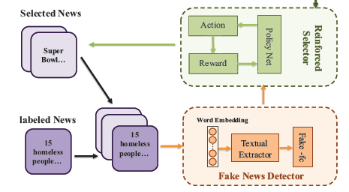
Fake News Detector
The final component of the article is the fake news detector.
The fake news detector is a neural
network, which consists
textual feature extractor and
a fully-connected layer, namely Fake-fc, with corresponding
activation functions.
The input to fake news detector is news
content, and the output is the probability of the given news
being fake.
The fake news detector can predict the label
of all the news articles by a model trained on the enhanced
training set generated by both annotator and reinforced
selector.

Slide 10
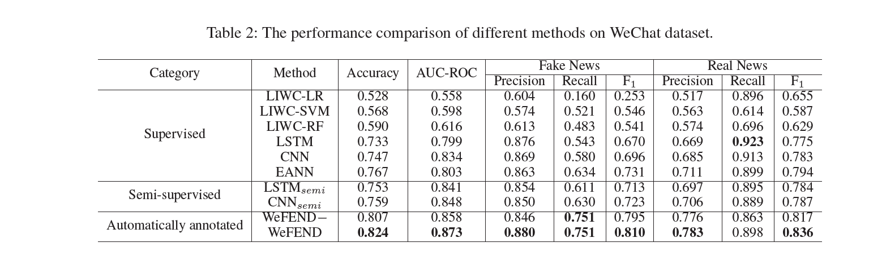
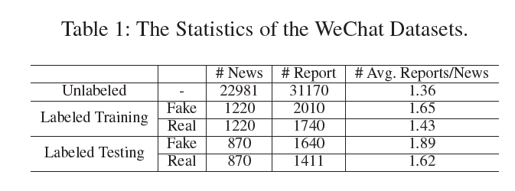
Experiments

Slide 11
Thank you ☺

